Slide 1
ARTIFICIAL INTELLIGENCE AND MACHINE LEARNING
HIERARCHIAL CLUSTERING
BY Ajinkya Mahure
Roll No: 238
t218068

Slide 2
CONTENTS
PROBLEM STATEMENT
INTRODUCTION TO HIERARCHICAL CLUSTERING
ADVANTAGES AND DISADVANTAGES
STEPS IN HIERARCHICAL CLUSTERING
TYPES OF LINKAGE
DATASET USED
IMPLEMENTATION

Slide 3
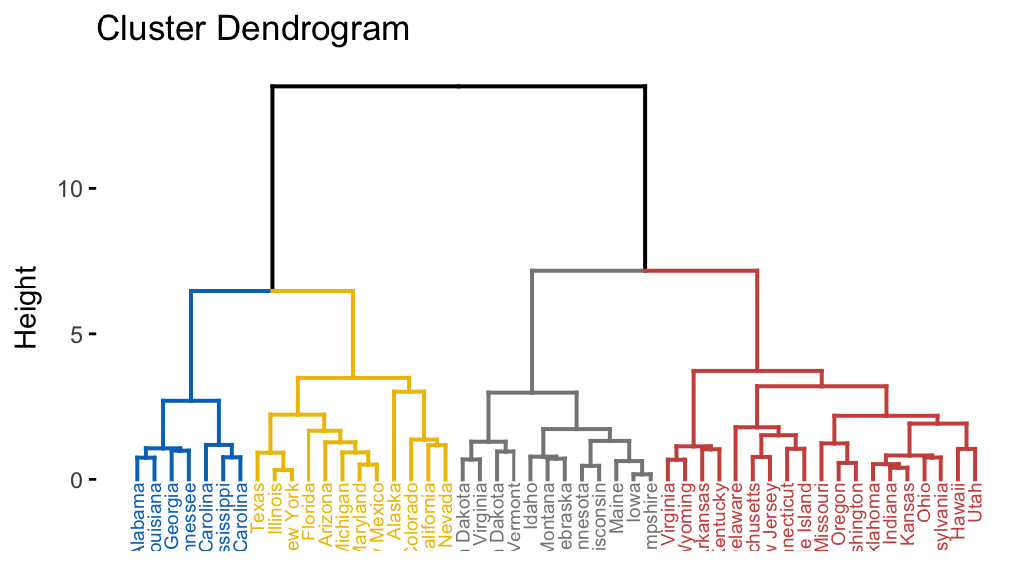
HIERARCHICAL CLUSTERING

Slide 4
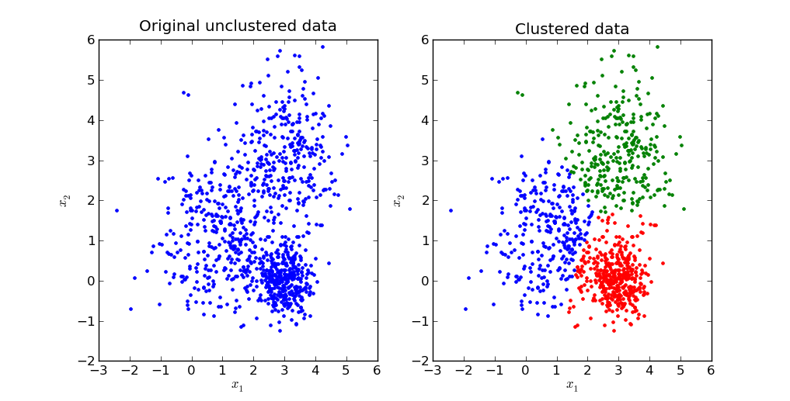
WHAT IS HIERARCHICAL CLUSTERING?
Hierarchical clustering, is an algorithm that groups similar objects into groups called clusters.
Also called Hierarchical cluster analysis or HCA is an unsupervised clustering algorithm which involves creating clusters that have predominant ordering from top to bottom.
The endpoint is a set of clusters or groups, where each cluster is distinct from each other cluster, and the objects within each cluster are broadly similar to each other.

Slide 5
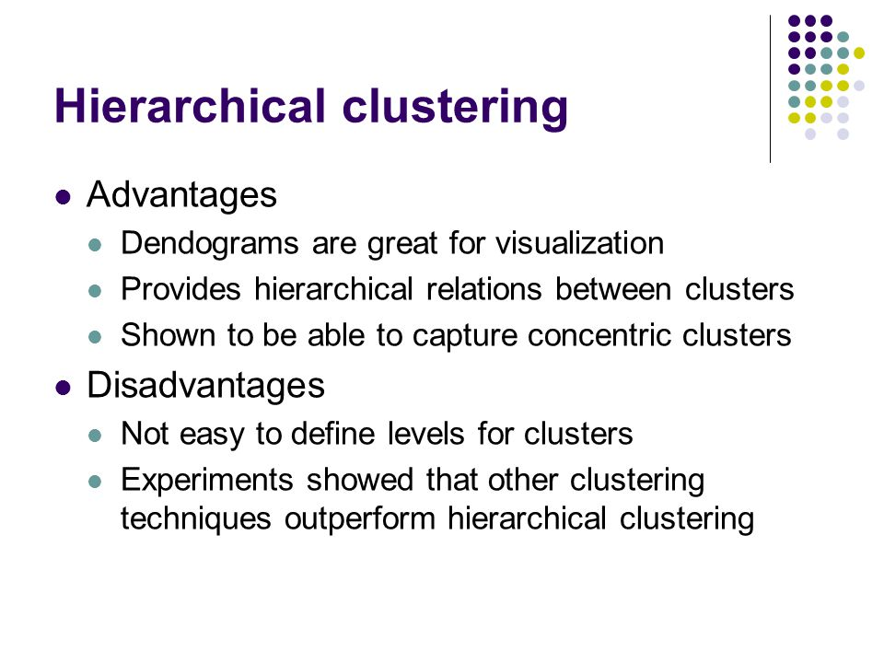
ADVANTAGES AND DISADVANTAGES

Slide 6
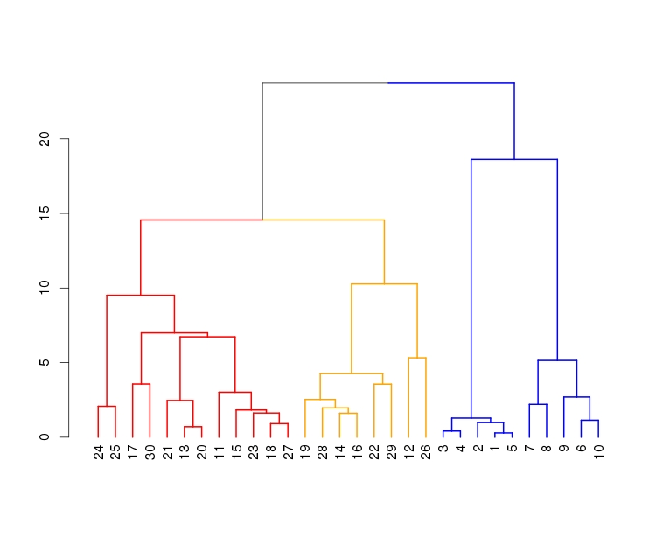
ALGORITHM STEPS
Hierarchical clustering starts by treating each observation as a separate cluster. Then, it repeatedly executes the following two steps:
(1) identify the two clusters that are closest together, and
(2) merge the two most similar clusters.
This iterative process continues until all the clusters are merged together.
The main output of Hierarchical Clustering is a dendrogram, which shows the hierarchical relationship between the clusters:
Representative picture of Dendrogram

Slide 7
DIAGRAMMATIC REPRESENTATION

Slide 8
TYPES OF LINKAGE
There are several ways to measure the distance between clusters in order to decide the rules for clustering, and they are often called Linkage Methods. Some of the common linkage methods are:
Complete-linkage: the distance between two clusters is defined as the longest distance between two points in each cluster.
Single-linkage: the distance between two clusters is defined as the shortest distance between two points in each cluster. This linkage may be used to detect high values in your dataset which may be outliers as they will be merged at the end.
Average-linkage: the distance between two clusters is defined as the average distance between each point in one cluster to every point in the other cluster.
Centroid-linkage: finds the centroid of cluster 1 and centroid of cluster 2, and then calculates the distance between the two before merging.
The choice of linkage method entirely depends on you and there is no hard and fast method that will always give you good results. Different linkage methods lead to different clusters.

Slide 9
DATASET USED
Football Analysis Contextual dataset is used based on the video game FIFA 19 from kaggle
The dataset contains 18207 rows and 89 columns in total
The huge length of data makes it interesting for data preprocessing and cleaning
It contains various columns full of categorical(qualitative) data and statistical(quantitative) data

Slide 10
IMPLEMENTATION

